Slide 1
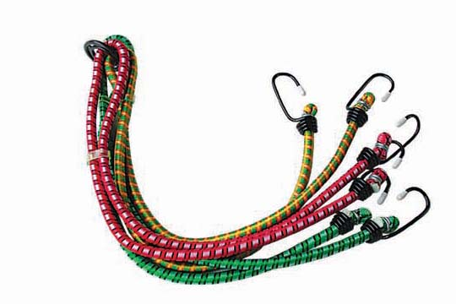
Bungee Cords

Slide 2
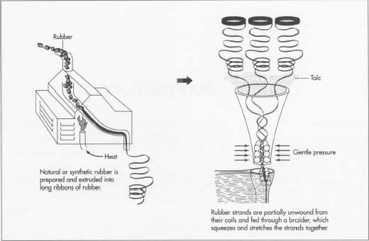
Bungee Cord Design
Bungee cord cores are made of strands of elastic material, usually natural (latex) or synthetic rubber. Both types share the same properties:
  Extensibility (ability to stretch)
  Resilience (ability to regain shape)
  Tensile (ability to extend under load without breaking
Natural rubber is stronger while synthetic rubber is more resistant to air and ultraviolent radiation in sunlight.
The core is wrapped in layers of braided rubber or fabric such as cotton or nylon.
http://www.madehow.com/Volume-2/Bungee-Cord.html
Making of Bungee Cord
Note: Certain cords are used in certain situations.

Slide 3
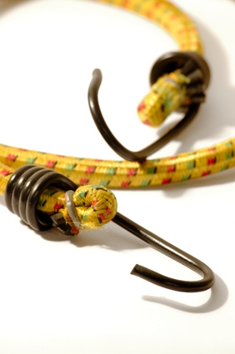
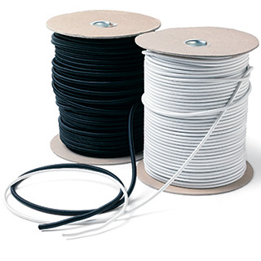
Design
Standard commercial bungee cord is available in diameters from around 0.25 inch to 0.62 inch (0.64-1.6 cm).
Military Spec cord: 0.25”-0.87”
Typical bungee jumping cord is around 0.62”.
“J” or “S” hooks are attached to each end. These hooks are generally made from steel and can be coated in materials such as plastic, dichromate, and zinc chromate. (http://www.superiorbungee.com/index_files/Page440.htm)
http://www.encyclopedia.com/topic/bungee.aspx

Slide 4
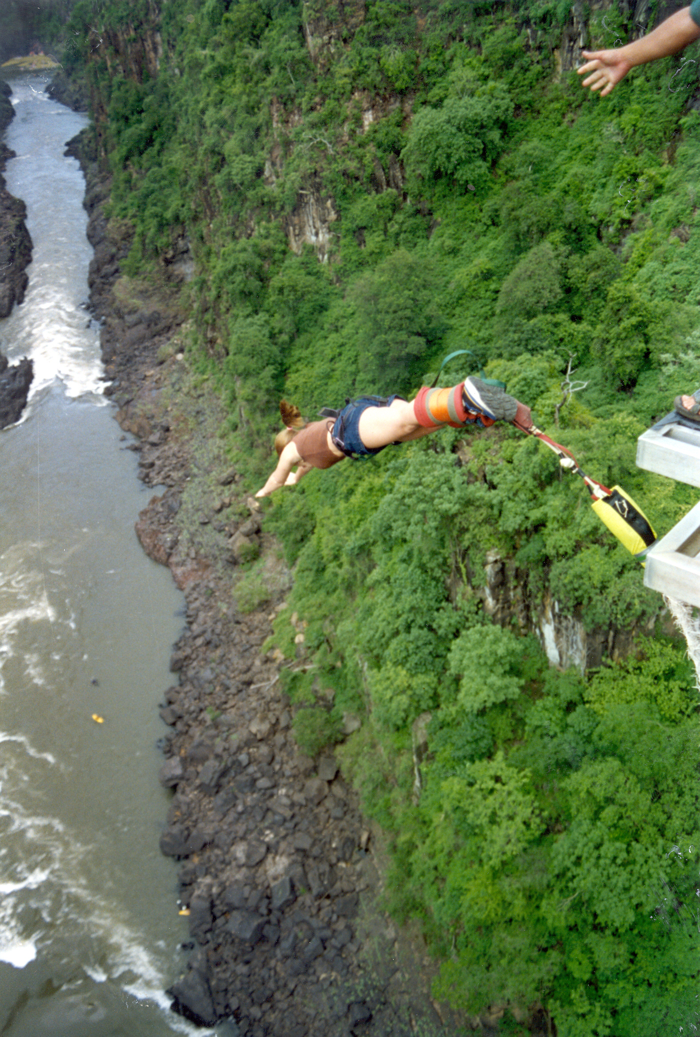
History of Bungee
The history of bungee cords starts 1500 years ago in Pentecost Island in what is now the Republic of Vanuatu in the South Pacific.
According to legend, a wife who felt as though she was being mistreated by her husband, fled from him, seeking refuge in a tree. As she was pursued, the wife secretly tied vines around her ankles; and when her husband finally grabbed her, she jumped. As the husband jumped after her, he plummeted to his death as she was saved by the vines.
From then on, the act of jumping from great heights attached to vines became a test of courage for men to never be tricked by women again.
http://www.madehow.com/Volume-2/Bungee-Cord.html

Slide 5

MORE HISTORY
The first bungee jump with a modern day cord was on April Fools Day in 1979, off of the Clifton Suspension Bridge near Bristol, England.
Members of the Oxford Dangerous Sports Club of Britain got the attention of the public as they sparked the use of bungee jumping as a commercialized sport.
http://www.ehow.com/facts_5018988_history-bungee-cords.html

Slide 6
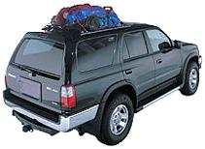
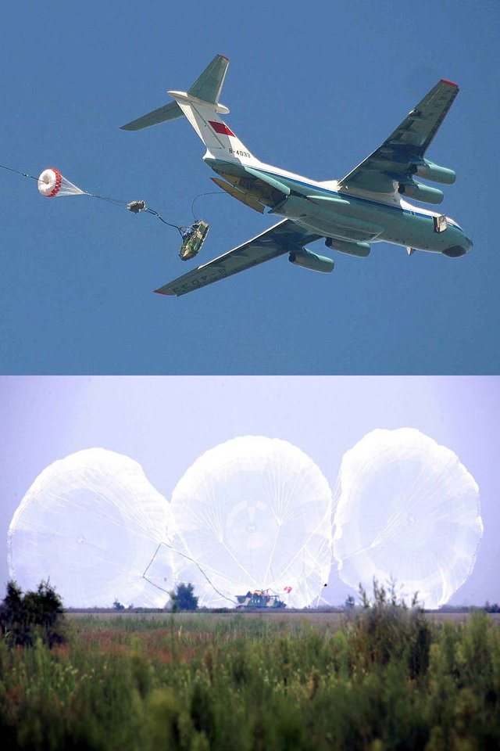
Bungee Cord Uses
Widely used in the cargo industry.
Commonly used as a tie-down to secure luggage or equipment to the exterior of a vehicle.
Also used by the Military to absorb the shock of opening parachutes with large cargo such as tanks or heavy equipment.
Athletes use cords to help improve speed and strength
http://www.encyclopedia.com/topic/bungee.aspx

Slide 7
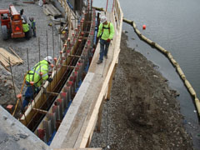
Construction Uses
Bungee cords can be used to hold forms together for concrete and masonry construction.
Safety harnesses utilize the properties of bungee cords to save lives.
Bungee cords can serve as good ways to secure materials and equipment to maintain an organized jobsite.

Slide 8
Concerns
The major concern with bungee cords is that they are often stretched past their maximum allowable tension.
  This can result in snapping if the force is great enough to break the cord, bend the hook or break the connection of the hook to the cord.
Bungee cords wear out from use over time.
Energy built up from stretching the cord can be released if not secured and cause serious damage to eyes such as loss of vision or even the whole eye.
  Approximately half of the eye injuries due to bungee cords require hospitalization.

Slide 9
Statistics
The majority of the bungee cord injuries result from the “J” or “S” hooks releasing and causing face or eye lacerations.
  They can travel up to 60 mph when released.
There are no recorded fatalities due to bungee cords in the OSHA data from 1990-2009
    There are currently no OSHA regulations for bungee cords
http://www.ehow.com/list_7561664_bungee-cord-specifications.html
http://www.chacha.com/question/what-is-the-death-rate-of-bungee-jumping

Slide 10
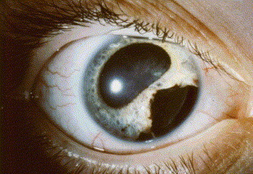
Example Injury Case
A 35-year-old man had decreased vision in his right eye after having been struck by a bungee cord while fastening luggage to his roof-rack.
http://www.sciencedirect.com/science?_ob=ArticleURL&_udi=B7CRN-4JVT1T2-1&_user=10&_rdoc=1&_fmt=&_orig=search&_sort=d&_docanchor=&view=c&_searchStrId=1116416170&_rerunOrigin=google&_acct=C000050221&_version=1&_urlVersion=0&_userid=10&md5=a0d882c181f2592df6d12d5fe6167e3d

Slide 11
Safe Practices
    Injuries can be avoided by wearing eye protection and not over-stretching the bungee cords. Stay clear of the line of fire.
    Specify someone on-site to test to make sure bungee cords are not frayed or damaged in any way.
    Test that tensile strength of cord is greater than the expected load.
    Replace the “J” or “S” hooks with spring loaded clips avoiding the possibility of the cord retracting and injury.
      Factor of Safety =
Minimum break strength
----------------------------------
Max expected load

Slide 12
Think Safety
_______________________
Work Safely

