Slide 1
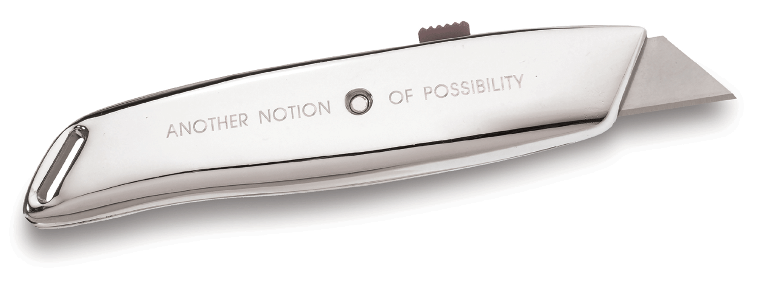
Box Cutters

Slide 2
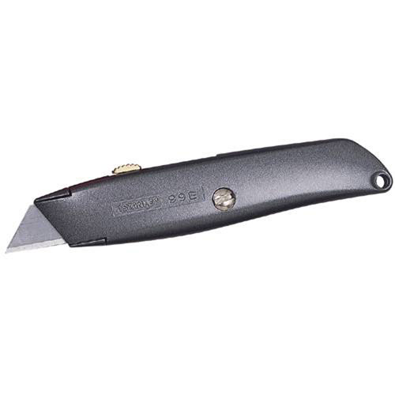
Box Cutters are hand-held tools with a short sharp blade that generally can be retracted.
Definition
Typical box cutter with protective housing and retractable blade.

Slide 3
Common Box Cutter Styles
Typical box cutter with full housing
Folding style pocket box blade
“Snap-Off” box cutter with adjustable blade length
Inexpensive fixed blade with metal sheath

Slide 4
Common Construction Usage
Sharpening carpenter’s pencil
Cutting carpet
Opening boxes
Scoring drywall
Removing sheathing from wire
Cutting shrink wrap
Cutting shingles
Cutting insulation
Removing shipping straps from pallets
Many utility applications (some without regard for the tool’s intended purpose)

Slide 5
Typical Hazards
Punctures
Lacerations (Cuts)

Slide 6
Recent Accident History
Construction laborer personnel incurred 26,960 days-away-from-work from box cutter injuries in 2009.
43% of these were contact with object or equipment, of which, 29% were cuts and lacerations.
That is 3,362 cuts and lacerations in 2009
Source: Bureau of Labor Statistics 2009, http://www.bls.gov/iif/#tables

Slide 7
Recent Accident History
Personnel engaged in materials handling in the construction industry incurred 135,350 nonfatal accidents in 2007
15.1% of these injuries resulted from cuts and punctures
15,560 reported cuts and lacerations
4,820 reported punctures
Source: Bureau of Labor Statistics 2007, http://stats.bls.gov/iif/oshwc/osh/case/osnr0031.pdf

Slide 8
Accident Data (not specific to construction)
2nd most frequent cause of days away from work
Source: U.S Bureau of Labor Statistics, http://www.bls.gov/iif/oshbulletin2006.htm

Slide 9
Accident Data
(not specific to construction)
Source: Bureau of Labor Statistics 2007, http://stats.bls.gov/iif/oshwc/osh/case/osnr0031.pdf

Slide 10
Understanding These Trends
Lacerations and punctures are severe injuries when they happen, but usually heal relatively quickly and do not have lasting debilitating effects on the injured.

Slide 11
Fatalities
Fatalities are not commonly associated with the use of box cutters
OSHA’s fatality investigation data from 1990 -2009 did not reveal any fatalities specifically attributed to box cutters
Source: Extracted from OSHA Accident Investigation Data 1990-2009

Slide 12
OSHA Regulations
No OSHA regulations specifically mention box cutters, however other regulations do exist that would merit compliance.
One example of an applicable regulation is:
1926.301(a)
Employers shall not issue or permit the use of unsafe hand tools.

Slide 13
Applicable PPE
Gloves
Use cut resistant gloves for laceration protection
Protection from snapped banding on boxes and crates
Protection from falling debris, especially when cutting overhead

Slide 14
Applicable PPE
Safety Glasses
Prevents broken blade from entering eye
Protects from snapped banding on boxes and crates
Protects from falling debris, especially when cutting overhead

Slide 15
Best Practices
Select quality box cutter with safety features
Train workers in proper usage and handling of tools prior to use
Self-Retracting Blade: Retracts when blade loses contact with cutting surface regardless of safety lock position
Automatic Blade Cover: Covers blade when blade loses contact with cutting surface. Variable blade depth controlled by blade cover

Slide 16
Best Practices
Use Right Tool For Job- Is The Box Cutter The Right Tool?
Use Rust Free and Sharp Blades Only
Ensure Blade Is Seated Properly
Pull Knife Toward the Body When Cutting, But Ensure Body Is Clear of Blade -- Make Several Passes If Needed
Retract, Cover, or Sheath Blade After Use
Never Leave Box Cutter In Work Area Unattended

Slide 17
Think Safety Work Safely

