Slide 1
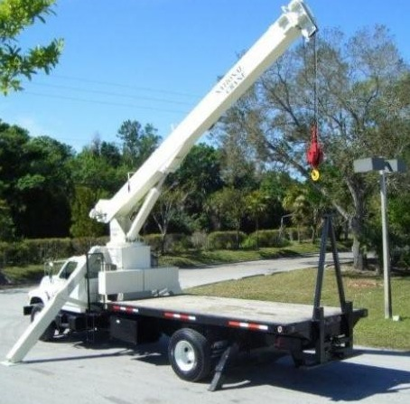
Boom Trucks

Slide 2
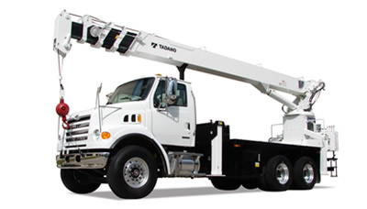
What is a Boom Truck
A boom truck is a large flatbed truck used to haul materials that is equipped with an integral boom for the purpose of loading and unloading materials. In some cases, baskets are attached to the end of a boom.

Slide 3
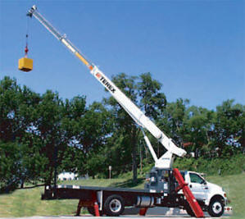
Hazards
Electrical
Overloading truck
Being struck by materials falling from boom or truck

Slide 4
Statistics concerning 59 boom truck fatalities

Slide 5
Boom truck Accidents
A two-man crew was installing light poles along a road. This installation required the use of a 16k boom truck and a towing trailer loaded with light poles.
During the process of the installation, the boom end was lifted above a set of power lines. The boom operator proceeded to lower the crane hook and accidentally made contact with a 7.2 kva high voltage power line.
One of the employees was holding onto a nylon sling that was wrapped around the light pole (and in contact with the truck). He was electrocuted.

Slide 6
Boom Truck Fatality
Two workers who were loading a fiberglass box onto the bed of a boom truck.
In doing so, one of the workers moved the boom slightly from its resting position with the pedestal controls.
At this point, the boom was facing the rear of the truck. However, the employee failed to extend the truck’s outriggers. He jumped in the basket at the end of the boom and proceeded to extend the arm until it was fully extended.
As a result, the boom truck turned over and the worker in the basket fell from 80’ to his death.

Slide 7
Boom Truck Fatality
A boom truck was moving a load of 28 sheets of OSB ply wood (approximately 1440 lbs.).
The construction site was a two story, single family residence.
As the boom truck was moving a material load over the stud walls of the second floor, the plywood slipped out of the sling. Given the plywood’s heavy load, the sheets ripped through the floor sheathing and trusses and struck and killed a worker who was standing beneath.

Slide 8
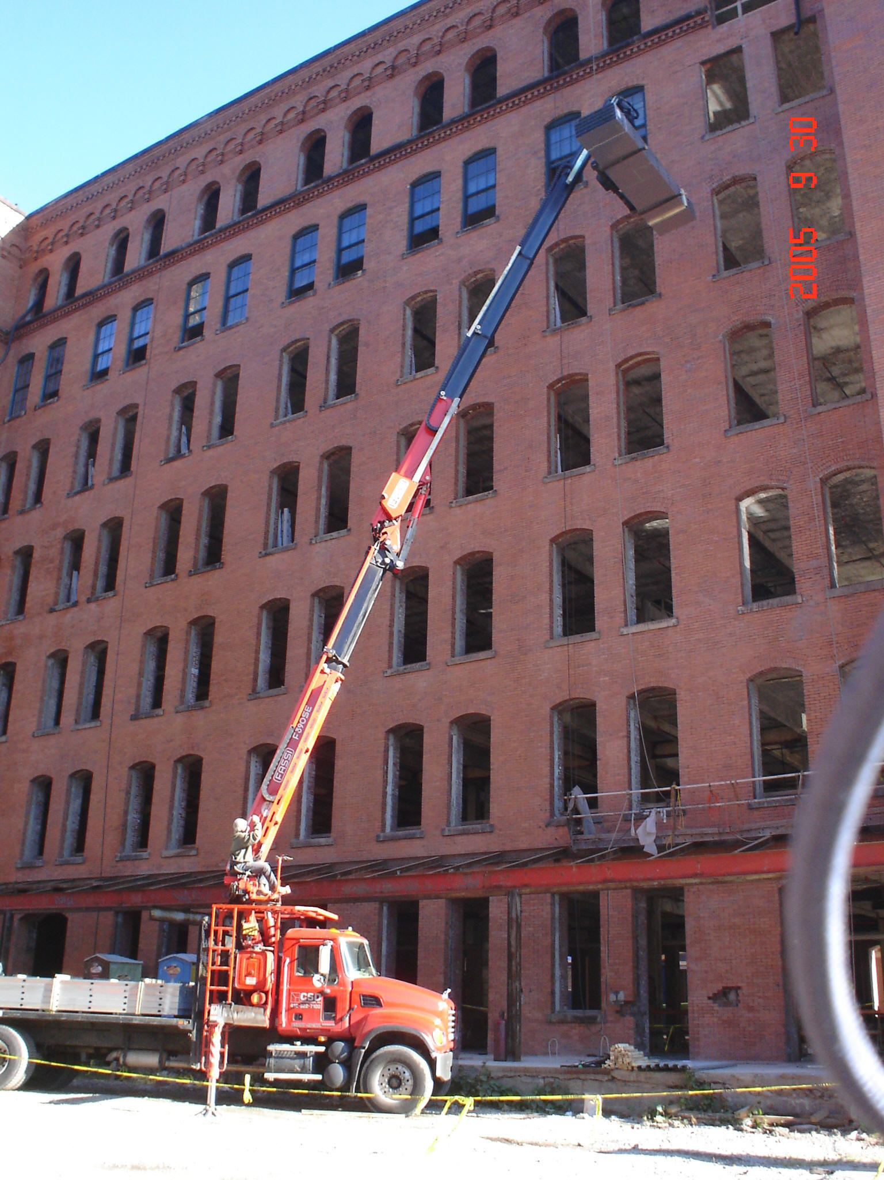

Slide 9
OSHA Safety Regulations
Although OSHA regulations do not specifically mention boom trucks by name, safety requirements concerning cranes and derricks are applicable such as subpart N:
Particular attention should be paid to provisions related to power lines.

Slide 10
1926.550(a)(5) The employer shall designate a competent person who shall inspect all machinery and equipment prior to each use, and during use, to make sure it is in safe operating condition. Any deficiencies shall be repaired, or defective parts replaced, before continued use.
1926.550(a)(6) A thorough, annual inspection of the hoisting machinery shall be made by a competent person, or by a government or private agency recognized by the U.S. Department of Labor. The employer shall maintain a record of the dates and results of inspections for each hoisting machine and piece of equipment. 1926.550(a)(6)

Slide 11
1926.550(a)(15) Except where electrical distribution and transmission lines have been deenergized and visibly grounded at point of work or where insulating barriers, not a part of or an attachment to the equipment or machinery, have been erected to prevent physical contact with the lines, equipment or machines shall be operated proximate to power lines only in accordance with the following: 1926.550(a)(15)

Slide 12
1926.550(a)(15)(i) For lines rated 50 kV. or below, minimum clearance between the lines and any part of the crane or load shall be 10 feet
1926.550(a)(15)(ii) For lines rated over 50 kV., minimum clearance between the lines and any part of the crane or load shall be 10 feet plus 1 foot for each 30 kV. over 50 kV

Slide 13
1926.550(a)(15)(iii) In transit with no load and boom lowered, the equipment clearance shall be a minimum of 4 feet for voltages less than 50 kV., and 10 feet for voltages over 50 kV., up to and including 345 kV., and 16 feet for voltages up to and including 750 kV.
1926.550(a)(15)(iv)A person shall be designated to observe clearance of the equipment and give timely warning for all operations where it is difficult for the operator to maintain the desired clearance by visual means;

Slide 14
1926.550(a)(15)(vi) Any overhead wire shall be considered to be an energized line unless and until the person owning such line or the electrical utility authorities indicate that it is not an energized line and it has been visibly grounded;
1926.550(a)(15)(vii)Prior to work near transmitter towers where an electrical charge can be induced in the equipment or materials being handled, the transmitter shall be de-energized or tests shall be made to determine if electrical charge is induced on the crane. The following precautions shall be taken when necessary to dissipate induced voltages:

Slide 15
1926.550(a)(15)(vii)(a) The equipment shall be provided with an electrical ground directly to the upper rotating structure supporting the boom; and
1926.550(a)(15)(vii)(b)Ground jumper cables shall be attached to materials being handled by boom equipment when electrical charge is induced while working near energized transmitters. Crews shall be provided with nonconductive poles having large alligator clips or other similar protection to attach the ground cable to the load.

Slide 16
Safe work practices
PPE:
  Hard hat
  Vest
  Eye protection
  Gloves

Slide 17
Safe Work Practices
Only workers associated with unloading materials should be in the immediate area.
Rigger and operator must always maintain clear communication.
Set outriggers to ensure stable and level load.

Slide 18
Safe Work Practices
Survey the area where materials are to be unloaded for encumbrances and potential hazards (e.g. power lines and/ or trenches).
Keep other equipment away from the immediate vicinity.
Be cautious when cutting straps used to bundle materials together.

Slide 19
Think Safety
Work Safely

