Slide 1
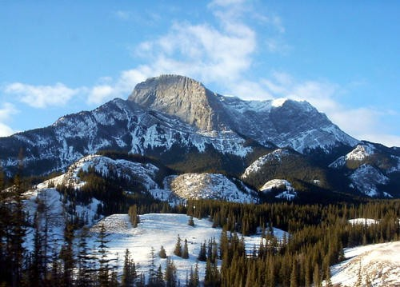
ALTITUDE
<number>

Slide 2
INTRODUCTION
40 Million people live at altitudes over 3000 m
Impossible to live at altitudes over 5500 m for more than a few months.
Improvements in technology are allowing for construction activities to occur in more difficult and dangerous areas.
Safety concerns include tight working spaces, maintenance of mechanical equipment and worker safety.
Medical concerns are very serious and attended to with every precaution.
<number>

Slide 3
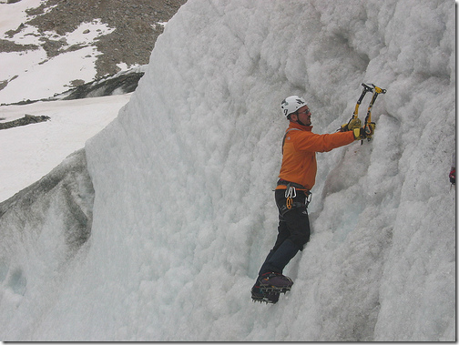
NOTABLE HIGH ALTITUDE CONSTRUCTION
Breckenridge, CO
Highest U.S. ski resort (12,998 ft.)
Source: http://www.breckenridge.com/mountain/mountain-information.aspx
Österreichischer Touristenklub
Austrian Tourist Club, Grisons Alps, Austria
Highest modern passive building (7,062 ft.)
Source: http://www.cipra.org/en/alpmedia/news/1810
Qinghai Tibet
Highest trail system (16,640 ft.)
Source: http://www.chinatibettrain.com/
<number>

Slide 4
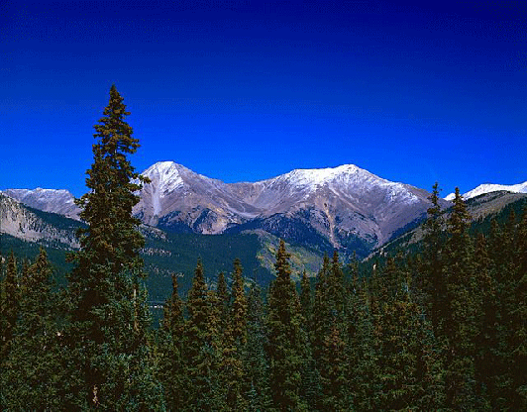
LOCATION
Highest Elevations in the U.S.
Alaska: 20,320 ft. (Mt. McKinley)
California: 14,494 ft. (Mt. Whitney)
Hawaii: 13,796 ft. (Mauna Kea)
Source: http://geology.com/state-high-points.shtml
<number>

Slide 5
EFFECTS OF HIGH ALTITUDE
All the medical effects of high altitude are caused by oxygen deprivation.
The reduction in oxygen is best described by the fall in inspired partial pressure of oxygen
These altitudes can have serious physical effects on humans.
The three major areas that are affected are:
Mental performance
Physical performance
Quality of sleep
Source: Curtis, Rick , Outdoor Action Program, 1995, Princeton University
<number>

Slide 6
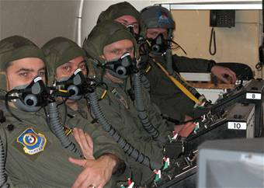
EFFECTS OF HIGH ALTITUDE
Mental Performance
arithmetical errors
reduced attention span
increased fatigue
impaired short-term memory
increased difficulty in making decisions.
Conditions improved after acclimatization.
<number>

Slide 7
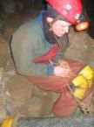
ACUTE MOUNTAIN SICKNESS
Typically occurs at elevations above 8,200 feet
Symptoms:
Nausea
Fatigue
Headaches
Vomiting
Insomnia
Source: http://firstaid.webmd.com/mountain-sickness-acute
<number>

Slide 8
ACUTE MOUNTAIN SICKNESS
Typically, symptoms can be reduced by descending in elevation
If descent is not possible, other treatments include:
Hyperbaric chamber (Gamow bag)
Oxygen respirators
<number>

Slide 9
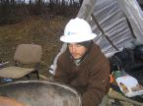
HIGH ALTITUDE CEREBRAL EDEMA (HACE)
Typically occurs at elevations above 13,000 feet
Symptoms:
Nausea
Fatigue
Severe Headaches
Vomiting
Lack of Coordination
Source: The Institute for Altitude Medicine at Telluride, CO.
<number>

Slide 10
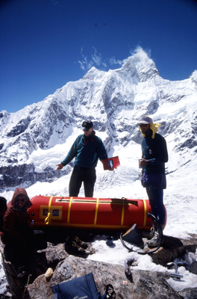
HIGH ALTITUDE CEREBRAL EDEMA (HACE)
Treatments:
Descending to a lower altitude
Significantly reducing heavy exertion for the first 1-2 days exposed to high altitudes
Dexamethasone pills
Source: The Institute for Altitude Medicine at Telluride, CO.
Hyperbaric chamber (Gamow bag)
<number>

Slide 11
HIGH ALTITUDE PULMONARY EDEMA (HAPE)
An accumulation of fluid in the air sacs of the lungs due to leaky capillaries
Severely inhibits exchange of oxygen in the lungs
Symptoms:
Shortness of breath with exercise
Persistent cough sometimes with blood
Chest tightness or congestion
Severe weakness
Source: The Institute for Altitude Medicine at Telluride, CO.
<number>

Slide 12
HIGH ALTITUDE PULMONARY EDEMA (HAPE)
Untreated patients can suffer comas and possible fatalities
Treatments:
Oxygen/hyperbaric chamber
Rest
Descent
Blood pressure medication
Source: The Institute for Altitude Medicine at Telluride, CO.
<number>

Slide 13
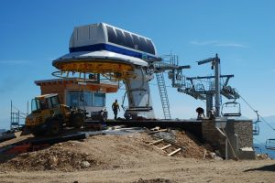
FATALITIES
No construction fatalities directly linked to acute mountain sickness, HACE, or HAPE investigated by OSHA from 1990 thru 2009
It must be realized that workers at altitude may be injured indirectly because of the hazards associated with working at altitude
Source: Extracted from OSHA Accident Investigation Data 1990-2007
<number>

Slide 14
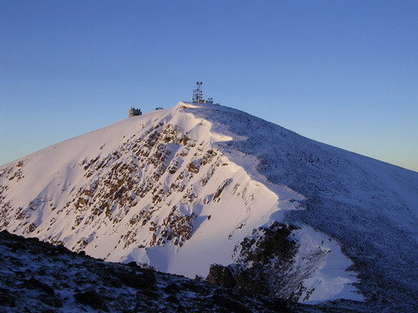
ALTITUDE AND OSHA GUIDELINES
There are no directly applicable OSHA regulations pertaining to working at altitude.
<number>

Slide 15
SAFETY PROCEDURES
When working in higher altitudes, greater strain is put on the body because of the lack of oxygen
Lack of oxygen causes a physical distraction for workers; distractions can led to more injuries and slower completion time
Workers should spend at least 1-2 days at high altitude before work begins
<number>

Slide 16
SAFETY PROCEDURES
Workers should not over-exert themselves
Workers should maintain good hydration, but not alcohol
Workers should stop working immediately if they feel any symptoms related to high altitude sickness as these symptoms will cause mental and physical distractions for the workers
Get lots of rest
Wear sunscreen as sunburns are easier to get
<number>

Slide 17
THINK SAFETY WORK SAFELY
<number>

